Slide 1
Redux
State of the App

Slide 2
Roadmap
Problem
Solution
What is Redux?
Principles of Redux
Flow of a React-Redux application

Slide 3
The Problems

Slide 4
Ever-changing state
Notes:
### Problems of React State
* State is ever-changing and is constantly being updated in React.
* Lots of components might be able to change state, and it gets difficult to keep track

Slide 5
Everything is connected
to EVERYTHING ELSE
Notes:
### Problems of React State
* State and props are tightly coupled with components and passed through parent;

Slide 6
If we make a change somewhere,
something else will break
Notes:
A single design change might involves a ton of code rewriting

Slide 7
Passing tons of props, needless rerendering
Notes:
### Problems of React State
* Large React apps require props to be passed needlessly throughout the component tree.

Slide 8
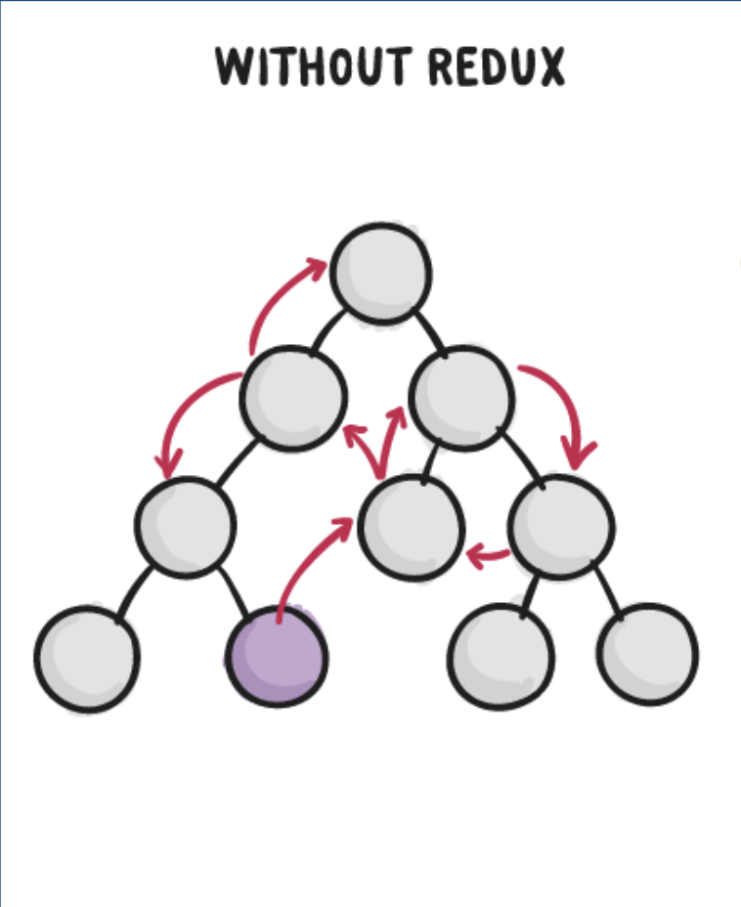

Slide 9
Solution: Redux

Slide 10

What is Redux?
A tiny library
A design pattern

Slide 11
What is the goal of Redux?
Make state changes predictable.
Notes:
* What Is Redux?
* The goal of Redux is to make state **global** and make all state changes **predictable**

Slide 12
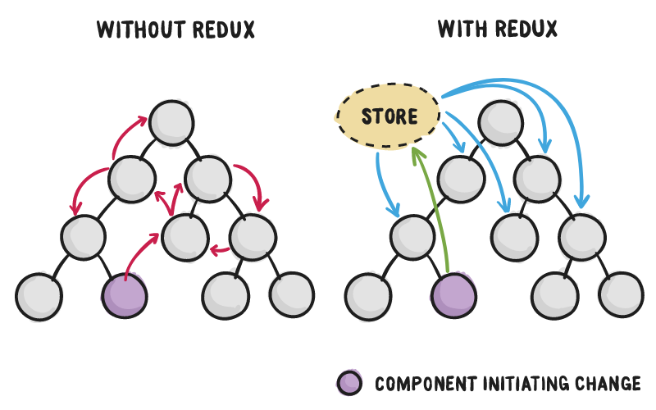
Notes:
* Redux at its core is a state manager built for React.js
* The main concept behind Redux is to store state in a central location and allow each component to access that state without having to send props down to child components or use callback functions to send data back up to the parent
Why Redux?
* As your React applications become increasingly more complex, State becomes increasingly harder to manage
* An app with 20+ stateful components in its structure ignores the single source of truth principle and changes in state are difficult to track
* Redux alleviates these issues by placing state in a single, central location that all of your components can interact with

Slide 13
Principles of Redux
Single Source of Truth
Read-Only
Pure Functions
Unidirectional Flow

Slide 14
Single Source of Truth
The state of your whole application is stored in an object tree within a single store.
Notes:
### Source of Truth - all of your state lives in one place
* We use the Redux store to contain a singular and universal state within our application.
* This single source of truth is called the store

Slide 15
*Store*
An object that has methods such as getState() and dispatch(). It is the gatekeeper for access and alterations to state.
There is only one store for a redux app.
Notes:
* Redux Store
* The Redux store is a plain JS object that exposes a few Redux specific methods like `dispatch` and `getState`. Our applications state lives here
* The store is created at the very beginning of an application with the `createStore` function

Slide 16
2. Read-Only
The state never changes.
The store is alerted of changes, and then based on that previous state, a new state is returned.
The only way to change state is to dispatch an action.
Notes:
### Reading and Writing to the Store
* With Redux, the state of our application will actually never *change*.
* Why? For the same reason we create new objects for updating state in vanilla React
Instead of setState(), we’re going to do something a little different
* Instead, the `store` is alerted of changes and returns a new state based off of the previous state and incoming alterations.
* The state can be manipulated by sending an "action" to a method called `dispatch`

Slide 17
*Actions*
An action is a plain object containing the instructions and information that describes the state change we expect to see.
An action is an object with two keys:
Type: the command describing the state change
Payload: any data needed to complete the state change
Notes:
* An action is a plain object containing the instructions and information that describes the state changes we expect to see
* Actions typically have two keys:
* `type`: a string used to identify the type of state change
* `payload`: any data needed to complete the state change

Slide 18
function
state
action
store
state
Notes:
Let’s this process to vanilla React

Slide 19
3. Pure Functions
When we get an action telling us how the state should change, we use pure functions that utilize pass by reference in our reducers to return a new state, not mutate the existing state.
Notes:
One more step missing in our process, which is when an action is dispatched, how does the state in the store change?
(let’s come back to this slide in a bit)

Slide 20
*Reducers*
Similarly to the reduce() method, reducers take in data and reduce it to a single object: the state
Reducers are functions with a switch statement that returns a new state based on the action type sent.
Notes:
* Reducers
* A reducer function's job is to read an action and return newly updated state
* When a Redux store is created via `createStore`, the reducer is given as its first argument
* A reducer function receives two arguments: the current state and an `action` object
* The return value of the reducer function will become the new state
* An easy way to remember the role of a reducer is that it takes two arguments and _reduces_ them to one thing, the new state
Reducers must be pure functions (go back)

Slide 21
action
Reducer (pure function)
New
state
Current
state

Slide 22
4. Unidirectional Flow
Component triggers an action
Action dispatched to reducer
Reducer returns the new state
Change in store causes rerender in components that rely on the piece of state that changed
Notes:
### Unidirectional Flow
* Manipulating the Redux store can be broken down to a series of unidirectional steps
1. Component triggers/dispatches an action
2. Action sent to reducer
3. Reducer returns the new state
4. Change in store causes re-render in components that rely on the piece of state that changed

Slide 23
action
Component
reducer
Store (new state)

Slide 24
Why was Redux hard for me?
Action Creators
Reducers
Store
Components
mapStateToProps
combineReducers
ALL_THE_CAPS
Dispatch
Provider
connect

Slide 25
Separate Concerns
React-Redux
Provider
connect
Components
mapStateToProps
Redux
Reducers
Store
Dispatch
combineReducers
Convention
ALL_THE_CAPS
Action Creators

Slide 26
Redux Glossary
Redux
Store
Actions
Reducers
Dispatch
Notes:
### Common Hurdles of Redux
* Global State:
- Students often struggled with understanding that their applications state now exists in one, solitary location. Previously, state existed in multiple locations and students were comfortable constructing stateful components. At first, it may seem odd for them to relocate every piece of their state to one place.
* Reducers:
- Students have difficulty understanding the role of reducers in their application and why we need them. The main role of a reducer is to interpret dispatched messages and tell the store to return a new version state.

